Slide 1
US Demographics and Public Resources
Sashimi

Slide 2
Chosen Datasets - Primary
American Housing Survey
Basic demographic, household income
Housing status and information
Predominant industry, employment rate, average working hour/week
Overall education level, school enrollment rate
Location in ZCTA5
Notes:
PK and FK
Xindi

Slide 3
Chosen Datasets - Secondary
Institute of Library and Museums
Discipline, income, revenue
Location in ZIPCODE, longitude, latitude
Education Demographic and Geographic Estimates
Public, private school and postsecondary school
Location in ZIPCODE, longitude, latitude
UDS Mapper
Location in ZIPCODE
Location in ZCTA5
Notes:
PK and FK
Mai

Slide 4
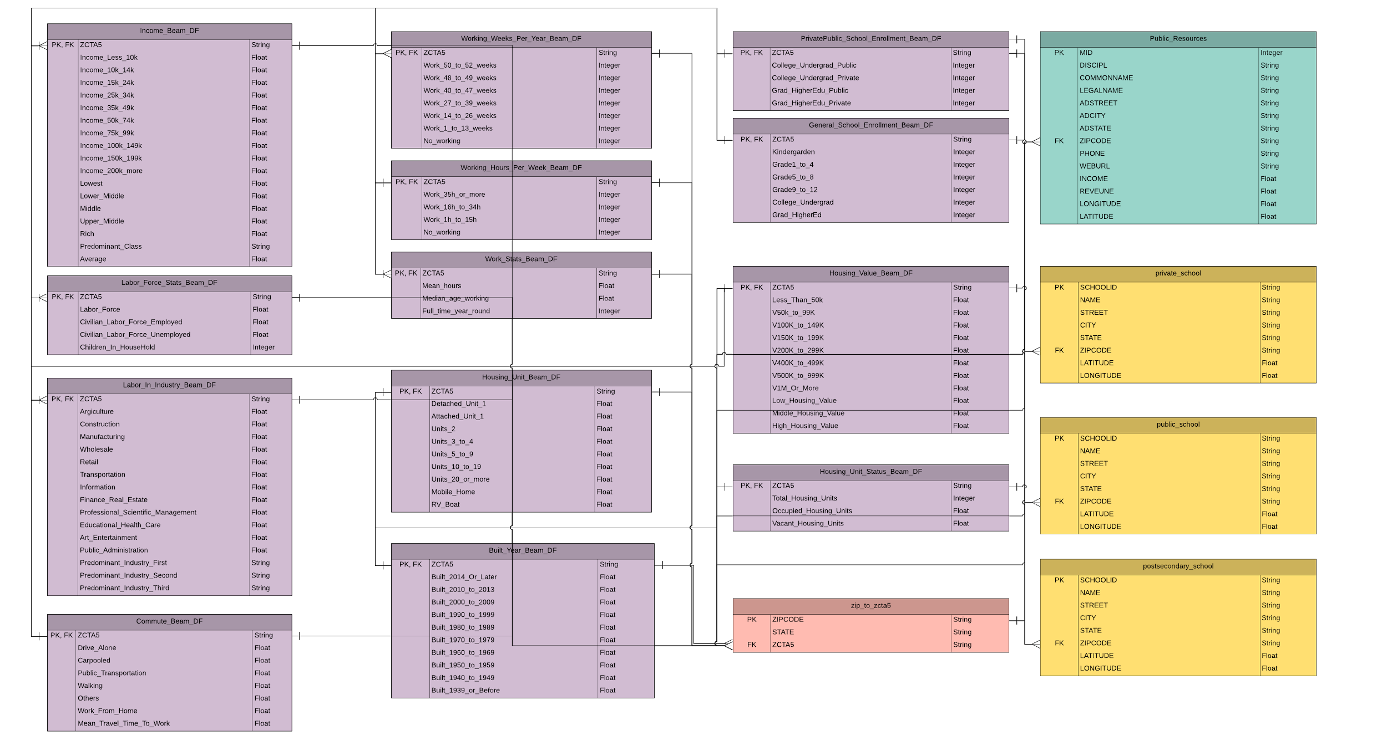
Notes:
Color and Zipcode - ZCTA
Mai

Slide 5
Area of Interest
Average housing value vs average household income
Nearby neighborhoods with distinct income, house value, education level
Which area has better public resources vs which area is lacking
Investment of area on education resources and its demand
Where public resources located vs living condition of the neighborhood area
Notes:
Xindi

Slide 6
Problems and Solutions
Massive Table
Column names
Different location keys (Zip Code vs. ZCTA5)
Omit unnecessary columns and split up table for normalization
Beam transform
UDS Mapper to connect
Notes:
Mai

Slide 7
Pipelines
SQL
Cast special null markers as ‘Null’
Update schema type
Beam
Update column names from code to human readable name
Generate columns through computation
DAG
Notes:
Mai

Slide 8
Live Demo
Income: generating average and assigning socioeconomic classes
Cross joins
Visualization
Notes:
I: Xindi
1 join: Mai
1 join + viz: Xindi

Slide 9
Future Improvements
Combine Schools with Libraries and Museums
Collect more data on government funding on each zip code
Zip Code might be too granular
Example: I live in Riverside but go to UT
Better estimate on the needed data to avoid unnecessary work
Notes:
Xindi

Slide 10
Thanks & Questions

